Slide 1
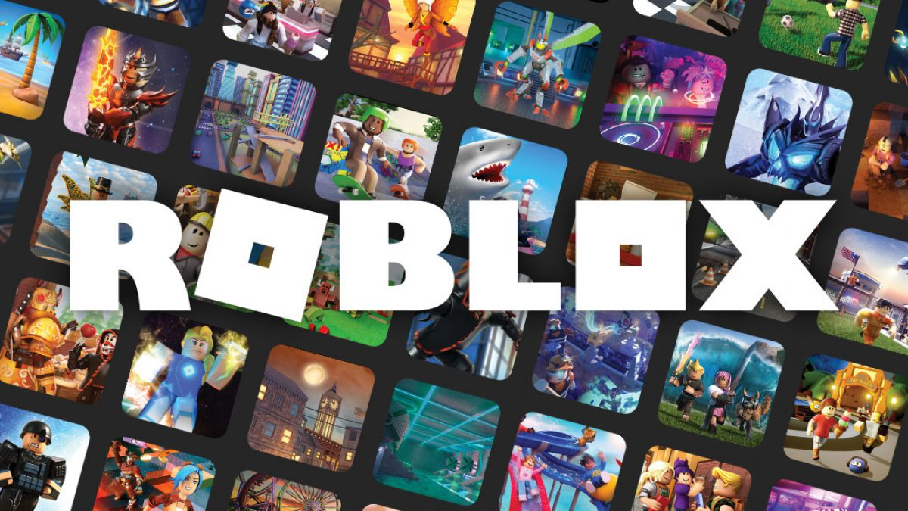
PROJECT
Alyson Amtman, Felix Pronove, Kim Christensen, Swati Oberon

Slide 2
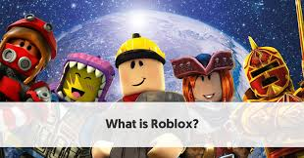
What is Roblox?
Interactive gaming platform and game creation system that allows users to program games and play games created by other users.
Roblox is ranked as one of the top online entertainment platforms for audiences under the age of 18
Notes:
Felix
Roblox is an online game platform and game creation system developed by the Roblox Corporation. It allows users to program games and play games created by other users. Founded 2004 and released in 2006, the platform hosts user-created games of multiple genres coded in the programming language Lua. For most of Roblox's history, it was relatively small, both as a platform and a company, due to the co-founders lack of interest in press coverage and it being "lost among the crowd" Roblox began to grow rapidly in the second half of the 2010s, and this growth has been accentuated by the COVID-19 pandemic.
Roblox is free-to-play, with in-game purchases available through a virtual currency called "Robux". As of August 2020, Roblox had over 164 million monthly active users, with it being played by over half of all children under the age of 16 in the United States. As of March 2021 it IPO’d at $38B as a company (RBLX) on the stock exchange.

Slide 3
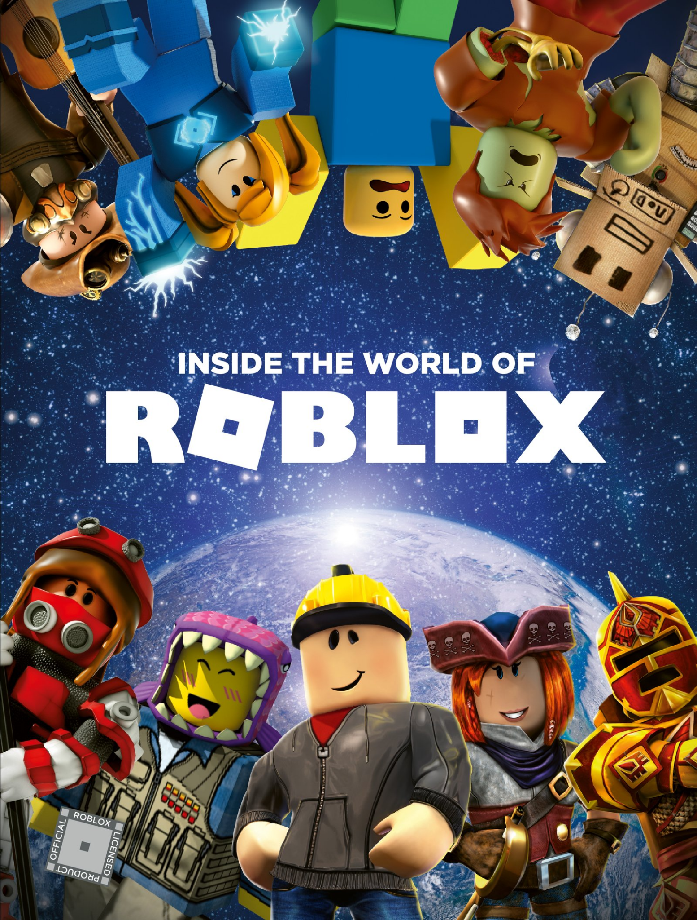
How does Roblox work?
Free to use base game with in-app purchases
It’s a proprietary engine
Games are coded under an object-oriented programming system.
Notes:
Alyson/Felix
Games are built by other users who sell features for Robux. Developers can exchange the Robux back for real money.
Roblox is free to use base game with in app purchases Roblox allows players to create their own games using its proprietary engine, Roblox Studio, which can then be played by other users. Games are coded under an object-oriented programming system utilizing a dialect of the programming language Lua to manipulate the environment of the game.Users are able to create purchasable content through one-time purchases, known as "game passes", as well as microtransactions which can be purchased more than once, known as "developer products" or "products". Revenue from purchases is split between the developer and the Roblox Corporation 30-70, in favor of Roblox Corp.The majority of games produced using Roblox Studio are developed by minors, and a total of 20 million games a year are produced using it.

Slide 4
Project Objective
Opportunity
With a vast and ever growing array of games, first time users might find it a little daunting finding the right game to play
What we offer
Create a service providing users with the following:
Top games based on category & desired filter
Top 5 YouTube tutorial videos for top games & desired filter
Notes:
Swati
What we have created is for gamers of all ages,backgrounds and walks of life. We have decided
create a platform for people who like to play Roblox. To get started select your game category of choice: Most Popular, Most Engaging, Up and Coming or Top Rated. After the selection, the top 10 games from the category will be reflected on the webpage. If you want to learn more about any game our web page will provide you with several of the top videos from YouTube to give the user a tutorial of how to play that game.

Slide 5

WHAT...Roblox Millionaires?
You heard that right! No matter your age, if you can code and create a game, you too can become a Roblox Millionaire…..
Notes:
Alyson/Swati
What’s this I keep hearing about Roblox millionaires?(The Irish Times)
As I stated Users create about 20 million new Roblox titles a year and receive a cut of revenue generated in their game. That can add up to quite a lot. Jailbreak, created in 2017 by then 18-year-old Alex Balfanz from Florida, has been played four billion times, bringing in millions of dollars annually. Balfanz told the New York Times that he used the cash to clear his college debts and buy a Tesla….so you too can aspire to be a Roblox Millionaire!

Slide 6
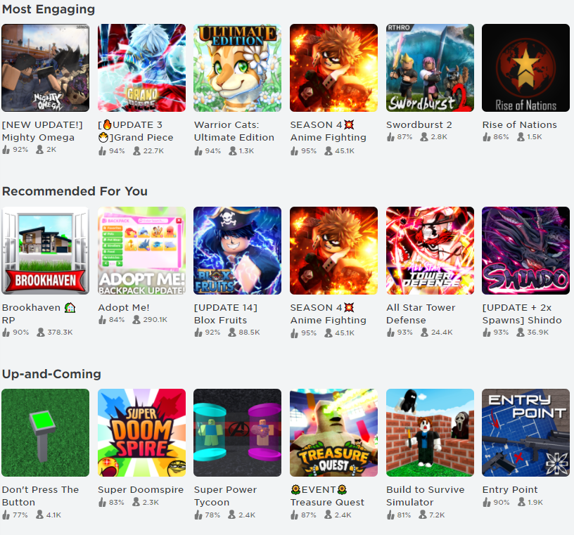
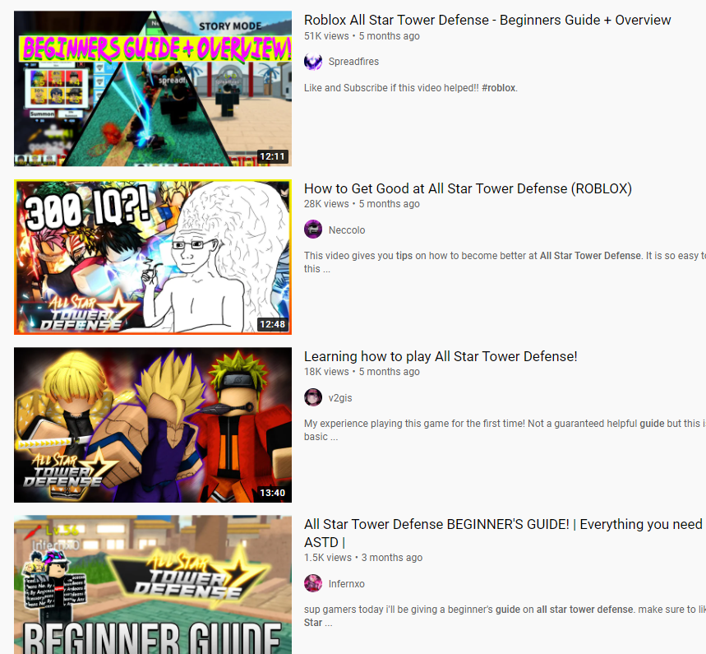
Data Sources
Roblox website
YouTube API
Notes:
Kim
We have scrapped data from the Roblox website and were able to get YouTube videos using a YouTube API key

Slide 7
High Level Concept
Database Connection/Data Manipulation
Roblox Website
Website
Top Games
YouTube tutorials
Game titles vs. Game categories
Database
Game Table
Video Table
YouTube API
Notes:
Felix

Slide 8
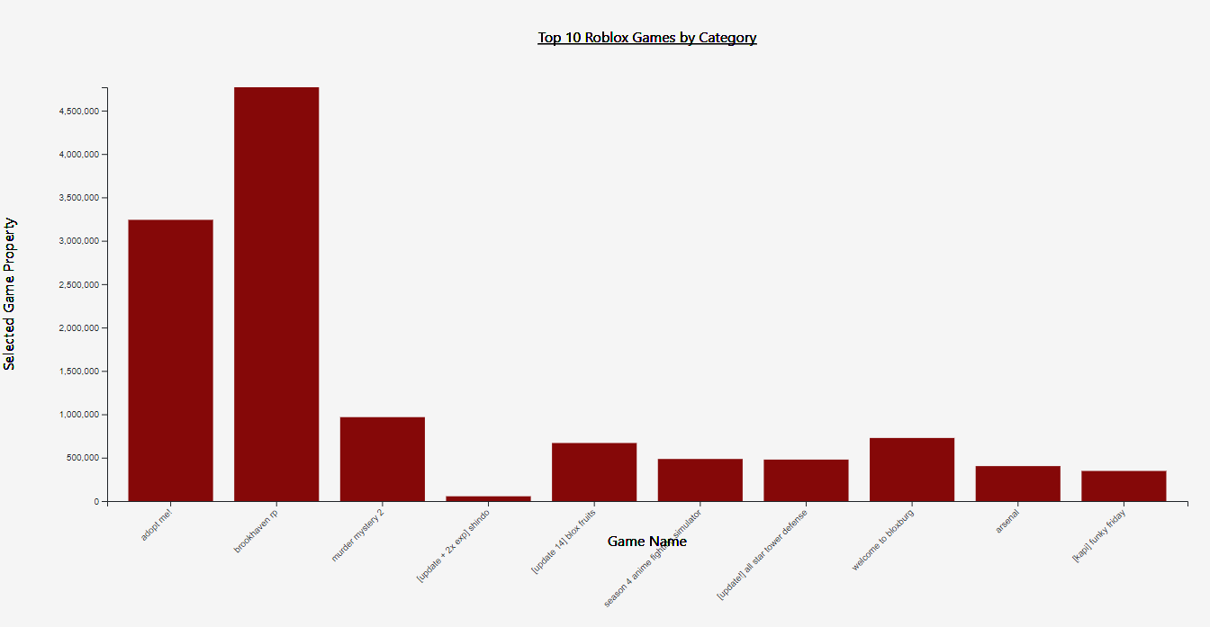
Visuals – Interactive Bar Chart
Notes:
Swati

Slide 9
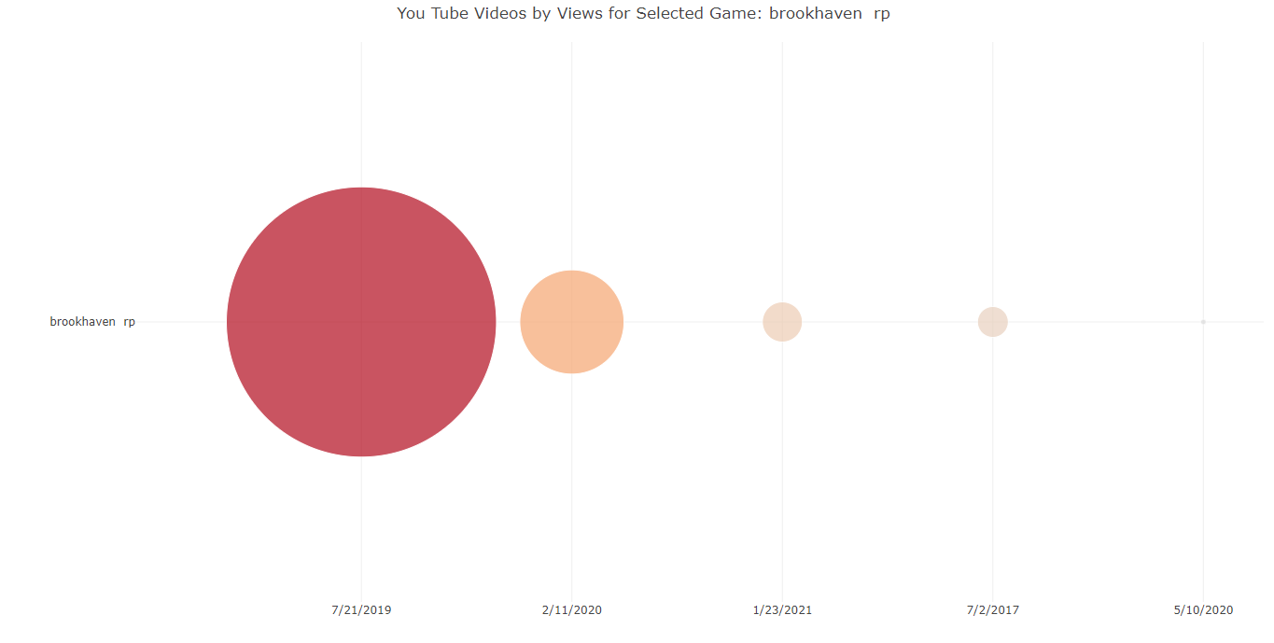
Visuals – Interactive Bubble Chart
Notes:
Alyson/Felix

Slide 10
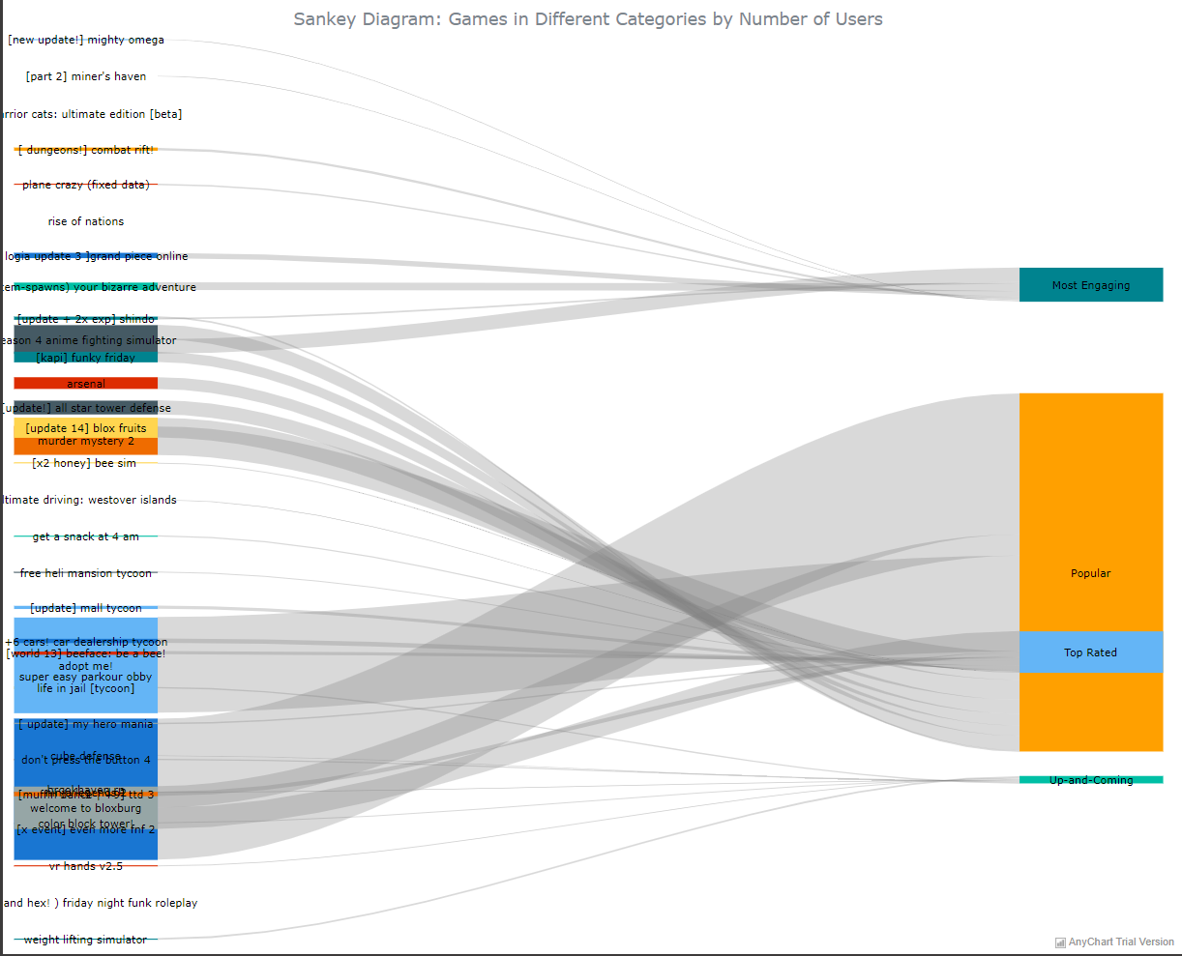
Visuals – Sankey Diagram
Notes:
Felix

Slide 11

Presentation of Roblox webpage
Notes:
KIM KIM KIM KIM

Slide 12
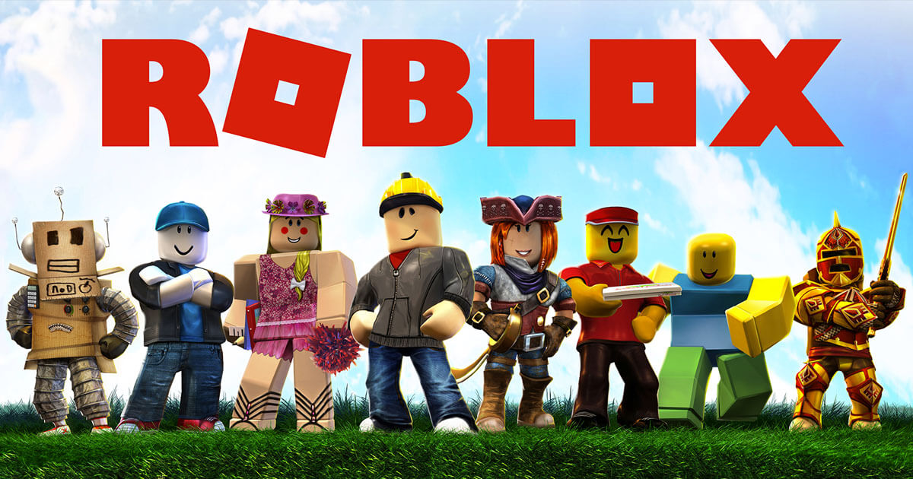
Roblox Roadblocks
Roblox web scrape
Updated data points
Visualizations
Sankey Diagram
Interactive visuals
Notes:
Felix/Swati

Slide 13

Lessons Learned
Extract your data
Easier visuals
Resilient code
Plotly pulls
2 brains > 1 brain
Notes:
Swati/Alyson/Felix

Slide 14
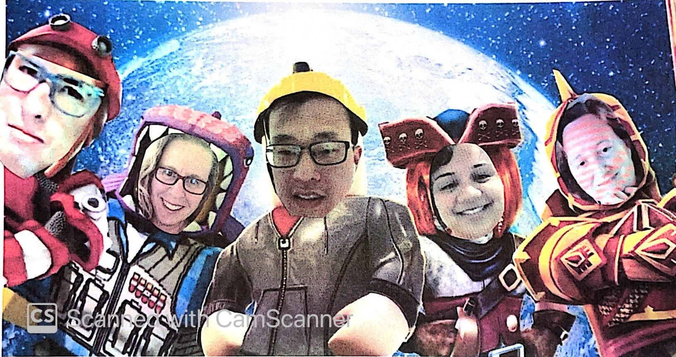
Our team is out of this world
Notes:
Alyson/Swati

